Slide 1
Synthetic Biology Open Language Visual An open-source graphical standard for synthetic biology
Jackie Quinn
SBGN 10 - August 17, 2014

Slide 2
SBOL and SBOL Visual
(the basics)

Slide 3
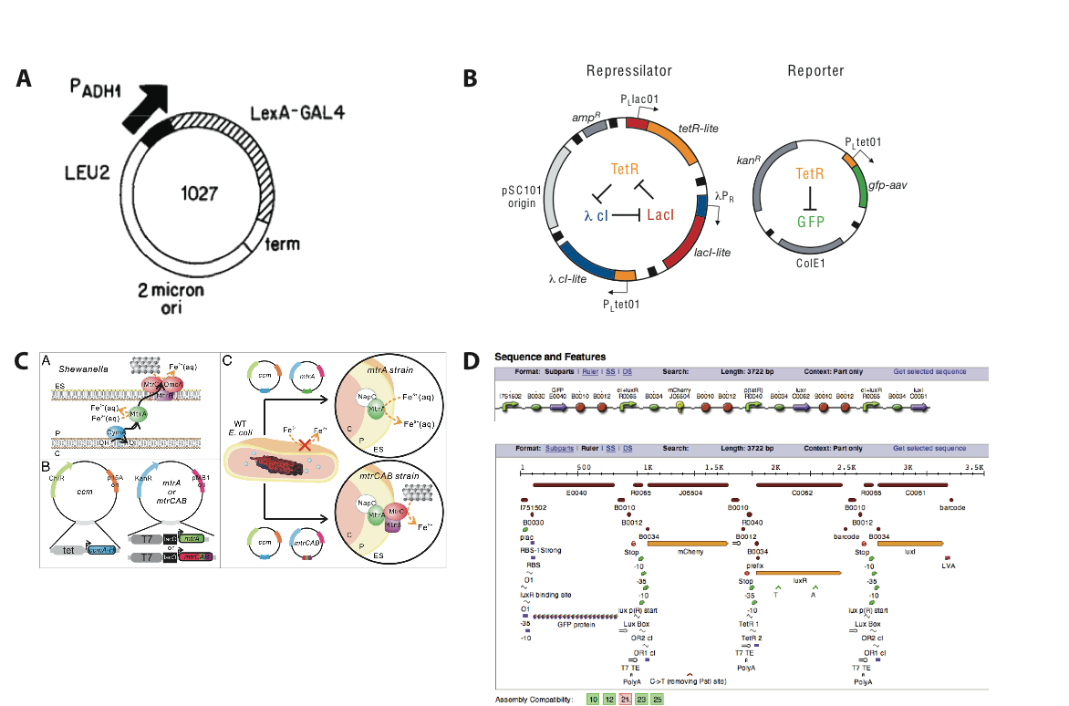
visual representation of genetic design

Slide 4
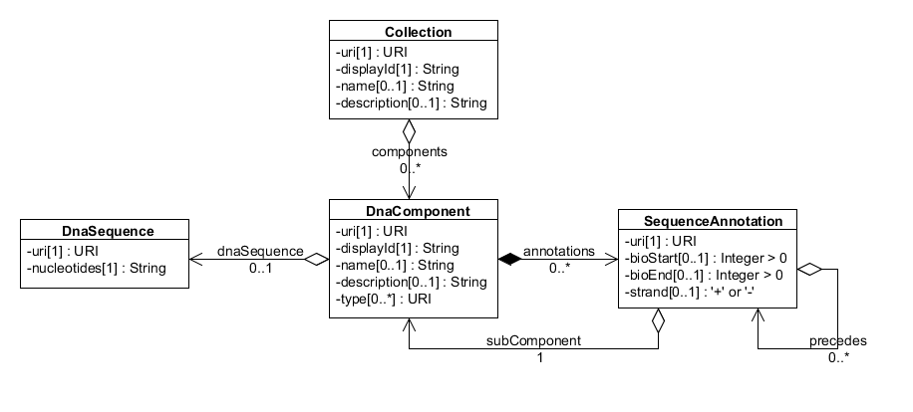

Slide 5
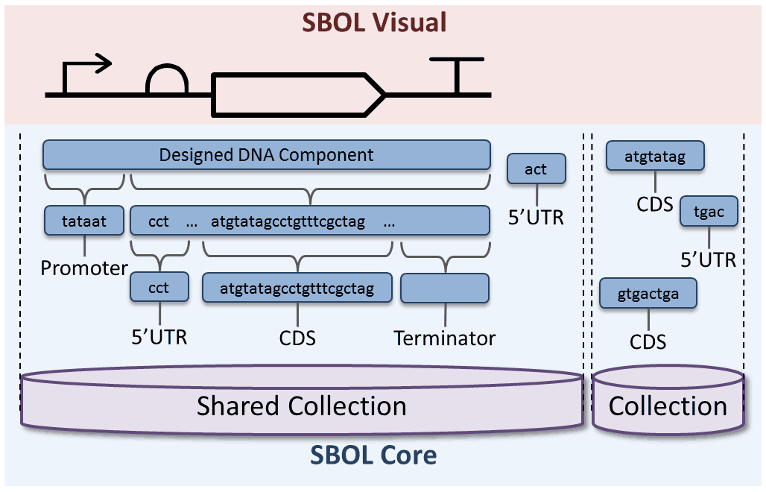

Slide 6
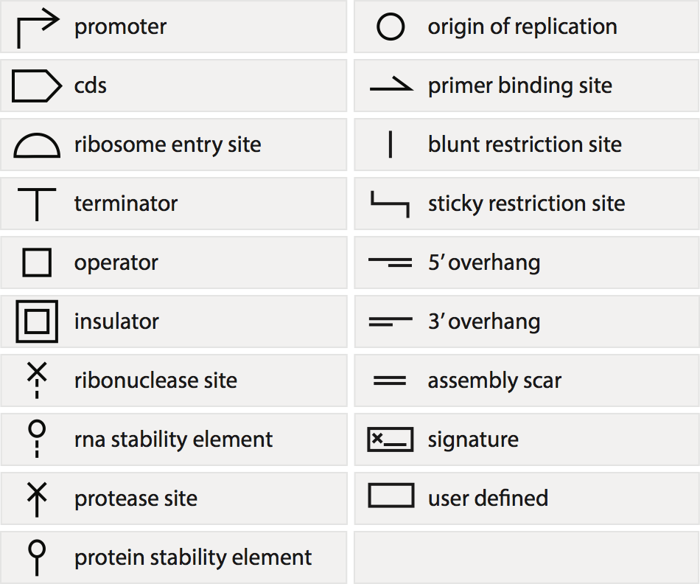
standardized symbol set

Slide 7
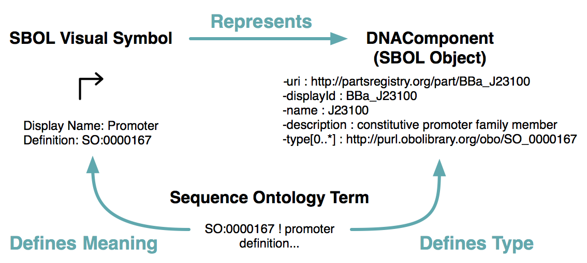
relationship to SBOL

Slide 8
use in various contexts

Slide 9
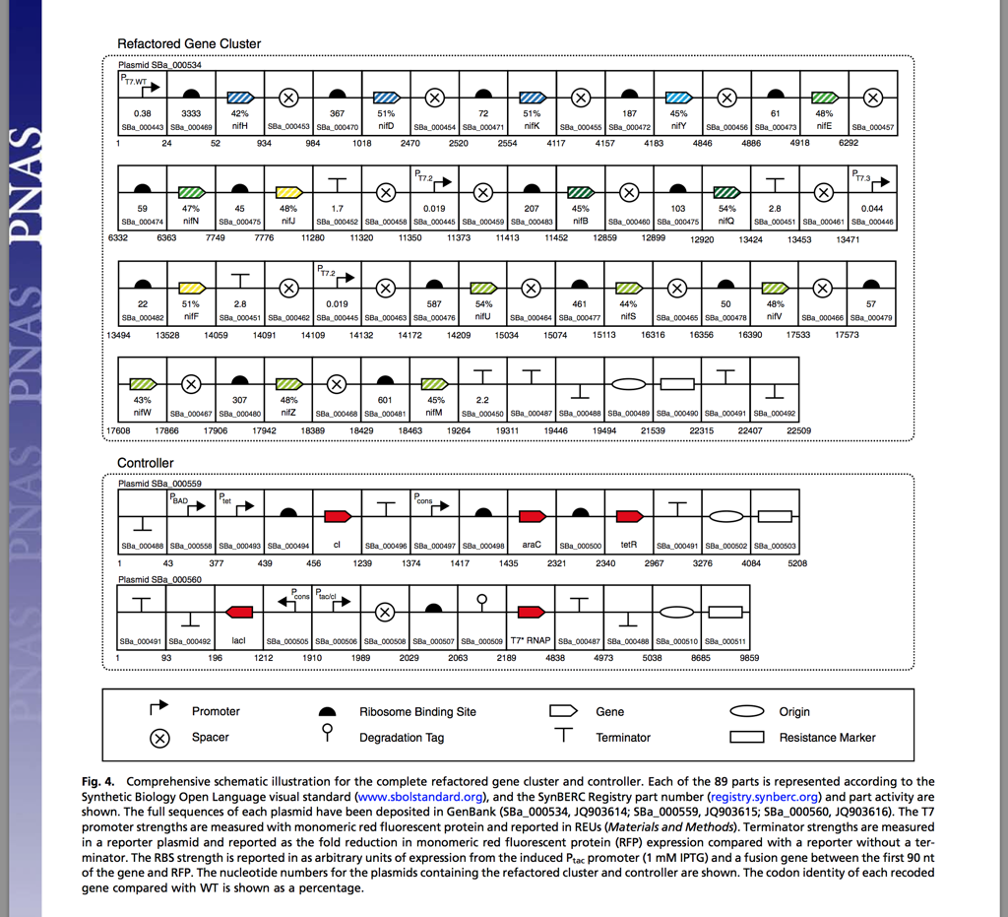

Slide 10
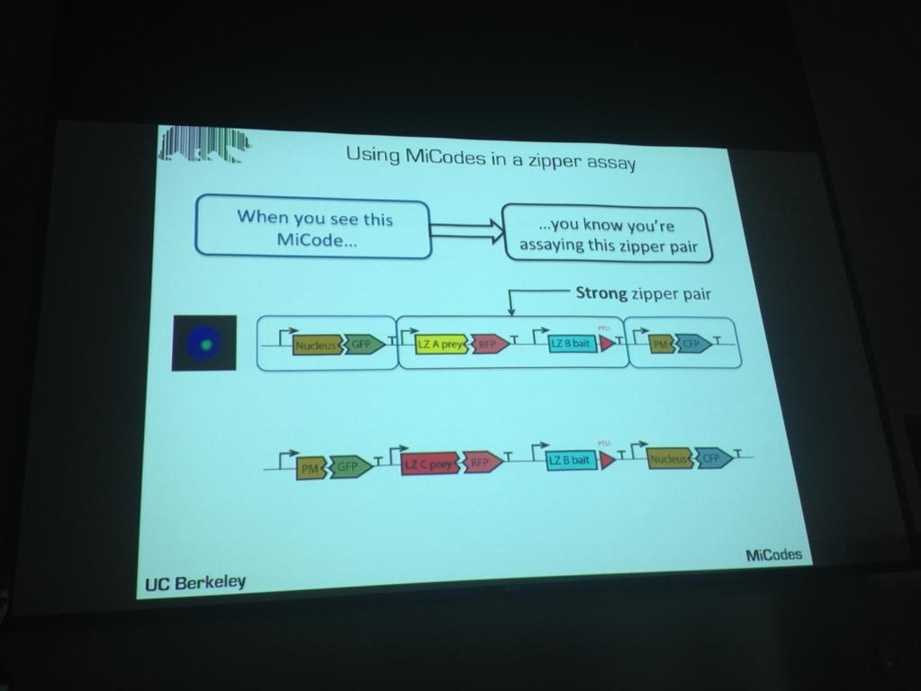

Slide 11
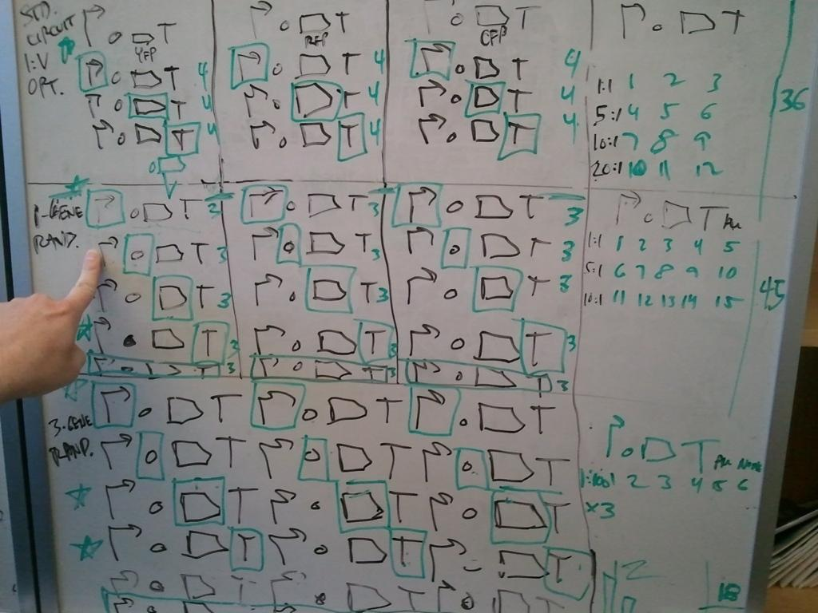

Slide 12
software

Slide 13
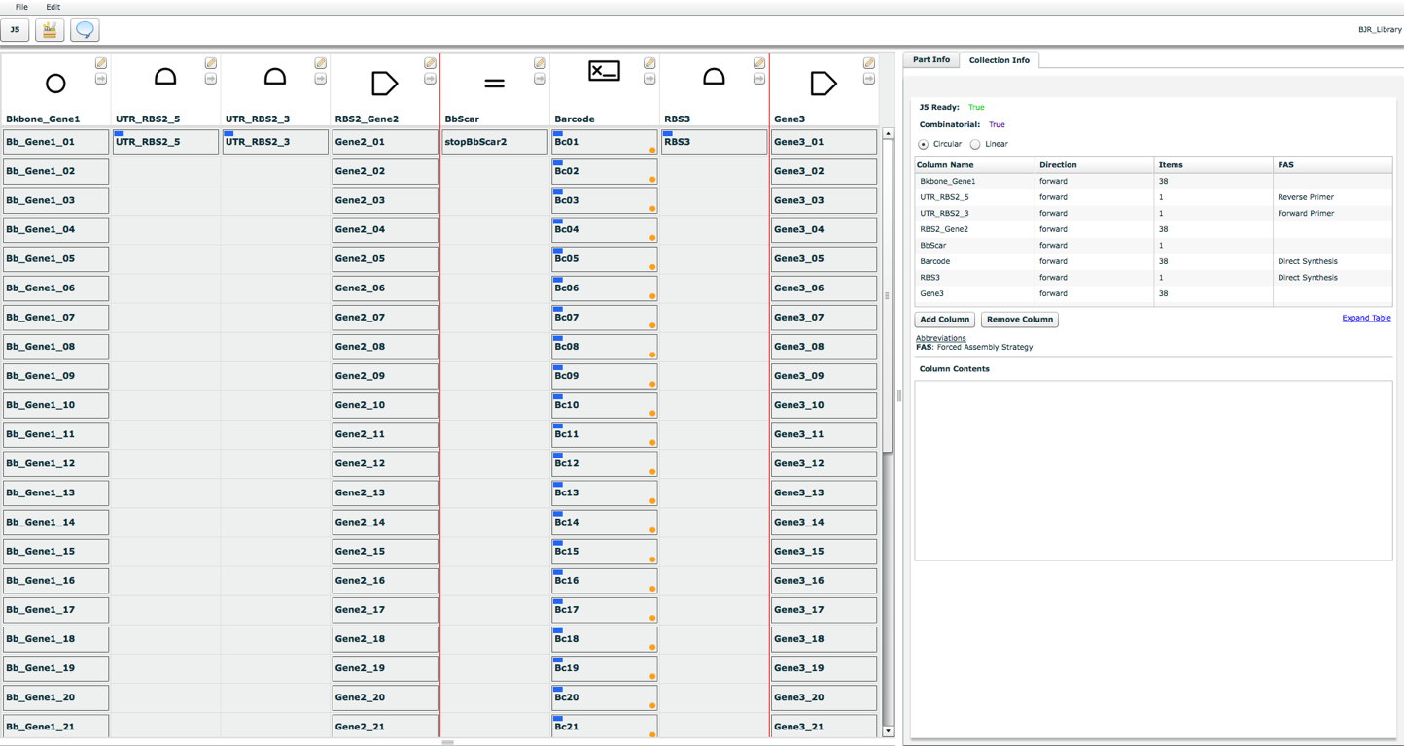
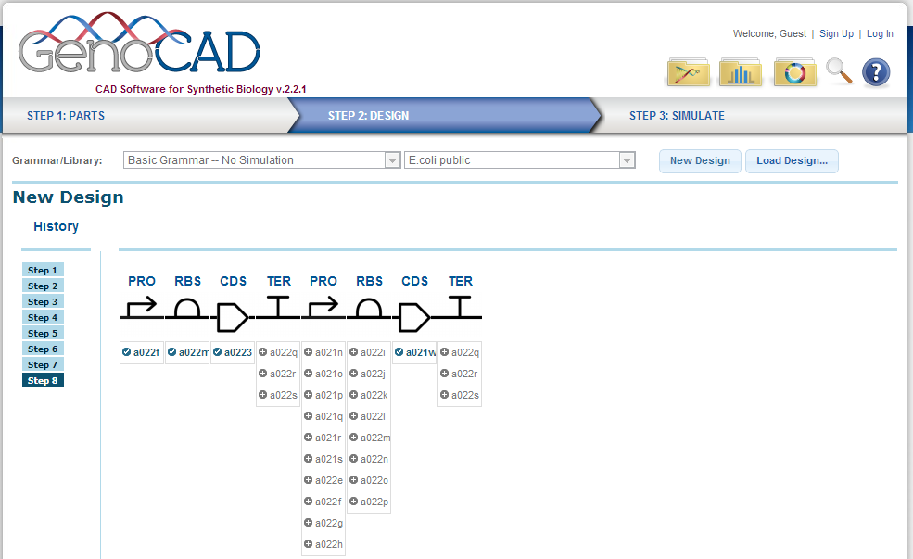
DeviceEditor
j5.jbei.org
GenoCAD
genocad.org

Slide 14
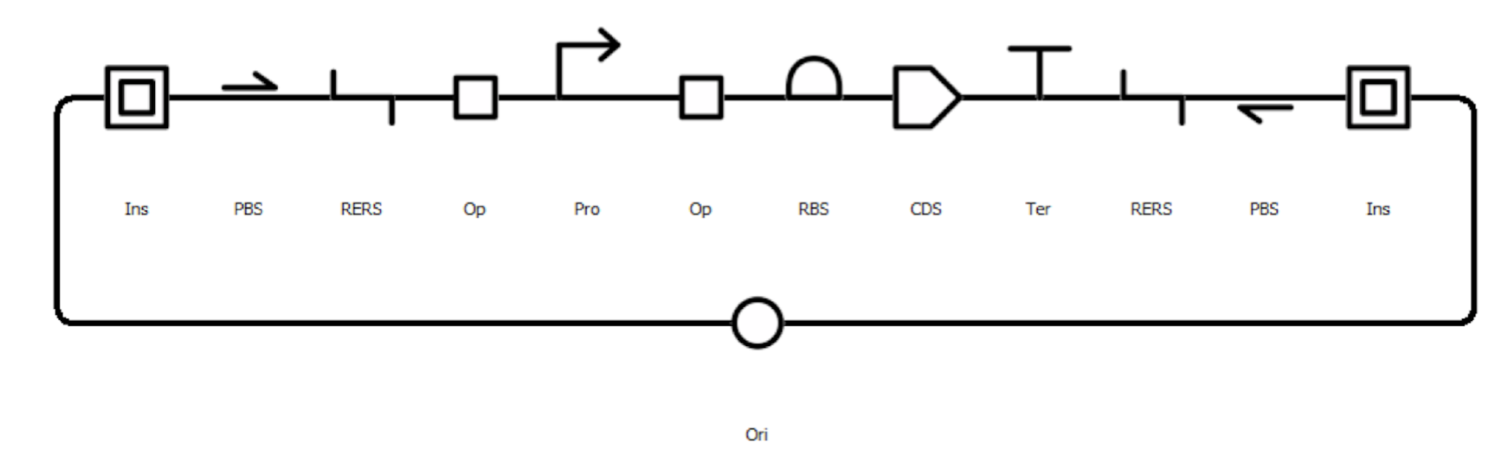
SBOL Designer

Slide 15
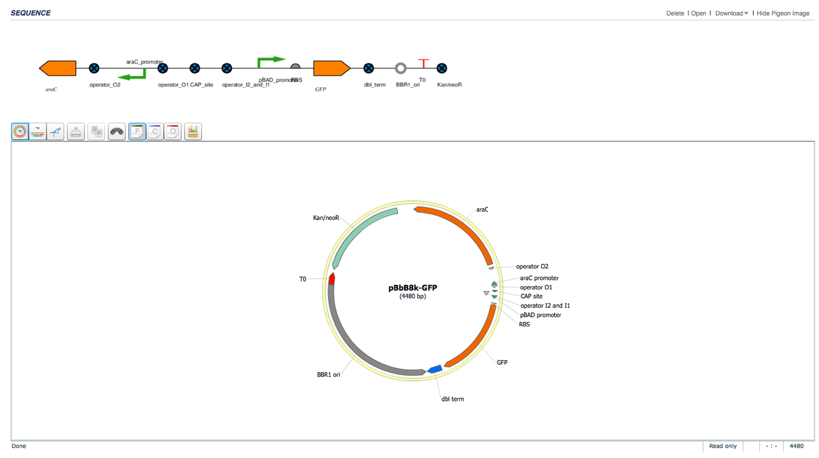
JBEI-ICE
public-registry.jbei.org

Slide 16
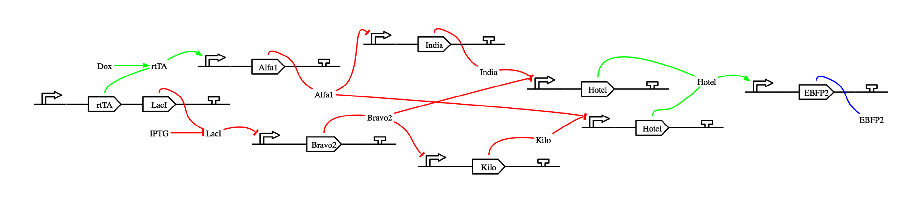
BioCompiler
synbiotools.bbn.com

Slide 17
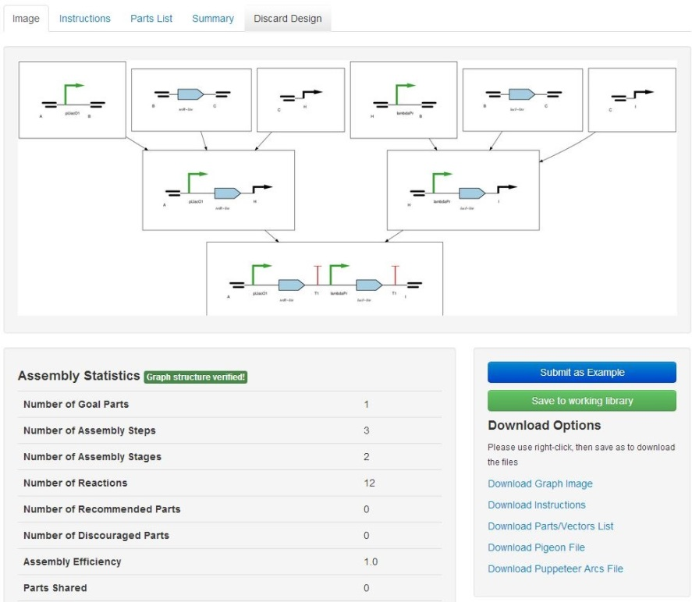
Raven

Slide 18
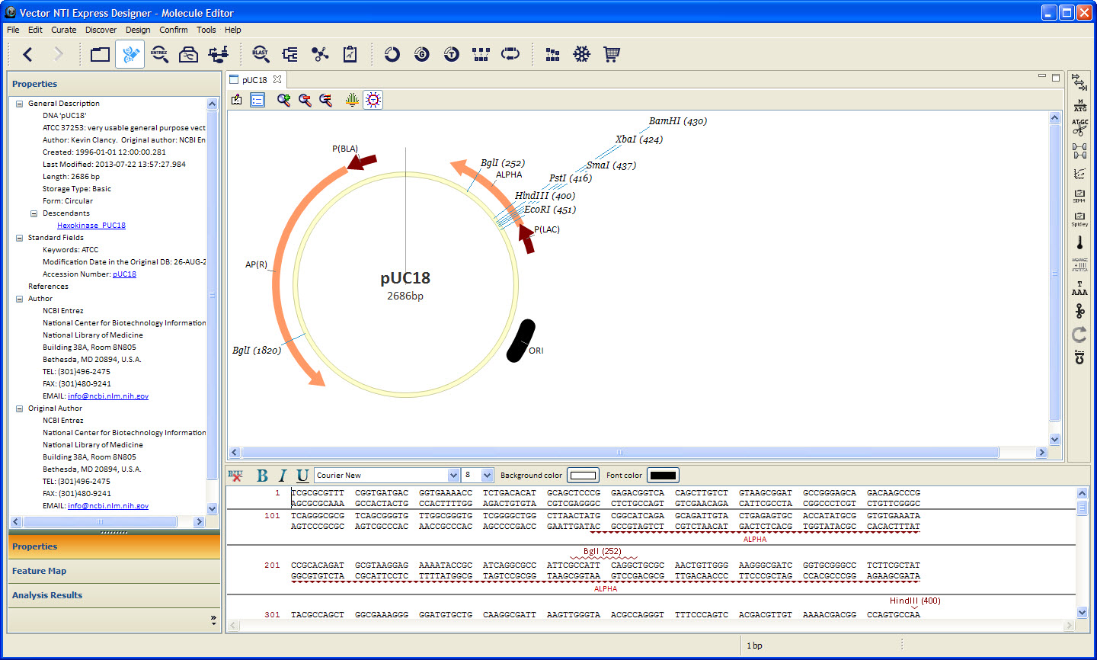
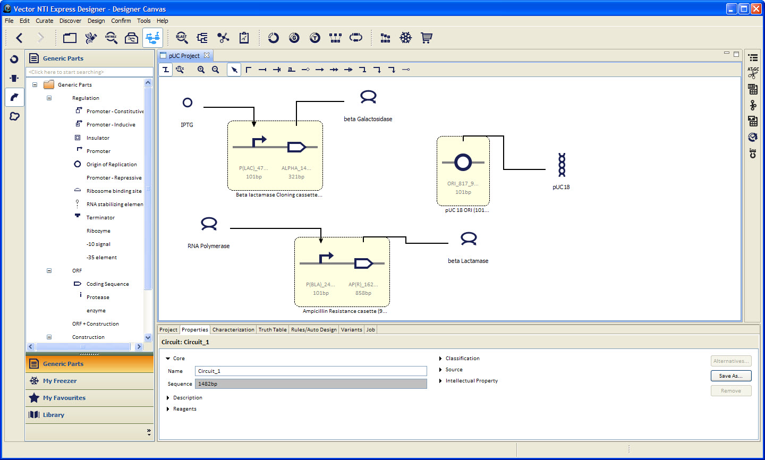
VectorNTI Express Designer

Slide 19
SBOL Visual 2.0?

Slide 20

SBOL Visual Working Group
Aaron Adler
Jacob Beal
Swapnil Bhatia
Patrick Cai
Joanna Chen
Kevin Clancy
Robert Sidney Cox III
Michal Galdzicki
Nathan Hillson
Cory Li
Chris Myers
Umesh P
Matthew Pocock
Jackie Quinn
Cesar Rodriguez
Herbert Sauro
Larisa Soldatova
Guy-Bart Stan
Grimaldo Urena
Alan Villalobos
Mandy Wilson

Slide 21
www.sbolstandard.org/visual visual@sbolstandard.org
Thank You!

Slide 22
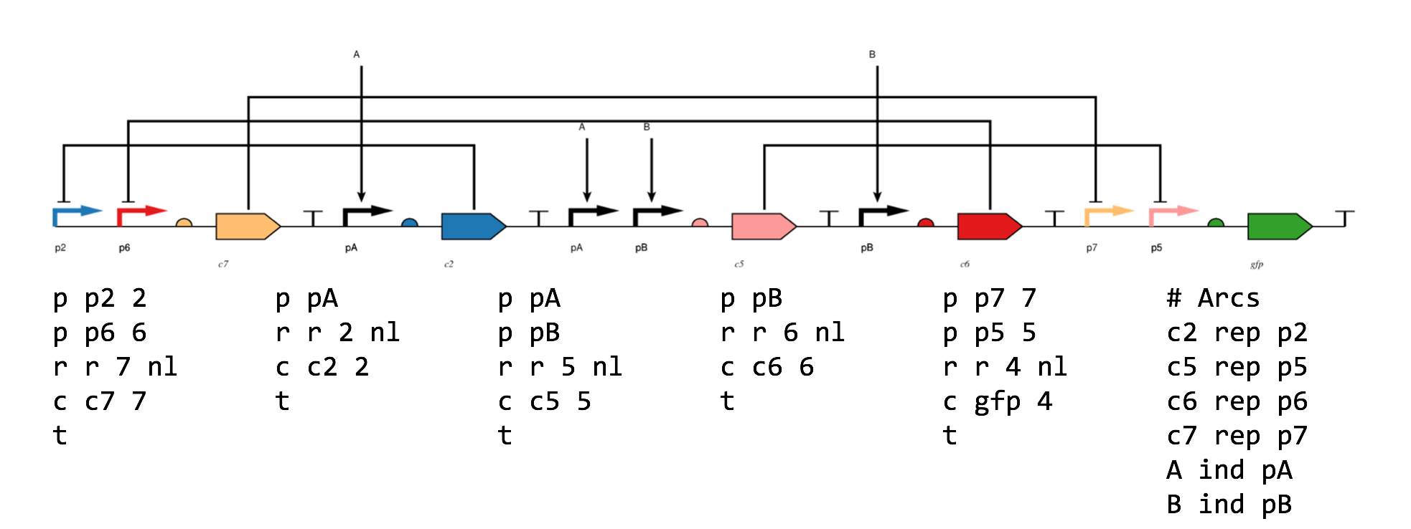
PigeonCAD
pigeoncad.org

